Slide 1
Game-shelf
{
< A fan website about my favorite games! >
}
...

Slide 2
What?
}
< A website about my favorite games, describing their stories and why I love them!>
*

Slide 3
->
Planning
{
..
< Using Frame0 to have a general outline of the project >
}
..

Slide 4
Pages and their wireframes!
*
Wireframes
Main Page - Including Menus and general idea
Main Page - Bottom / Footer part of the page, generally handling how the page should handle social media links etc.
Since all pages were basically planned to be a variation of the main page this kept planning time quite low.
The original plan was to use Balsamiq Wireframes but the app has gone paid subscription since the last time I used it and I had to find an alternative. What I settled on was “Frame0”.

Slide 5
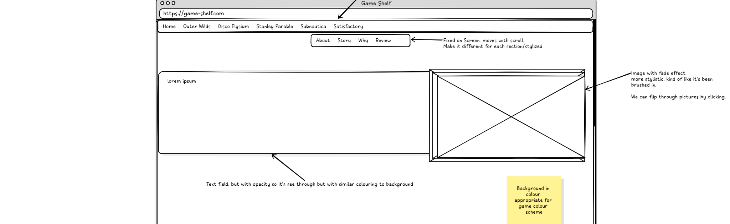
Wireframe for Main Page
*

Slide 6
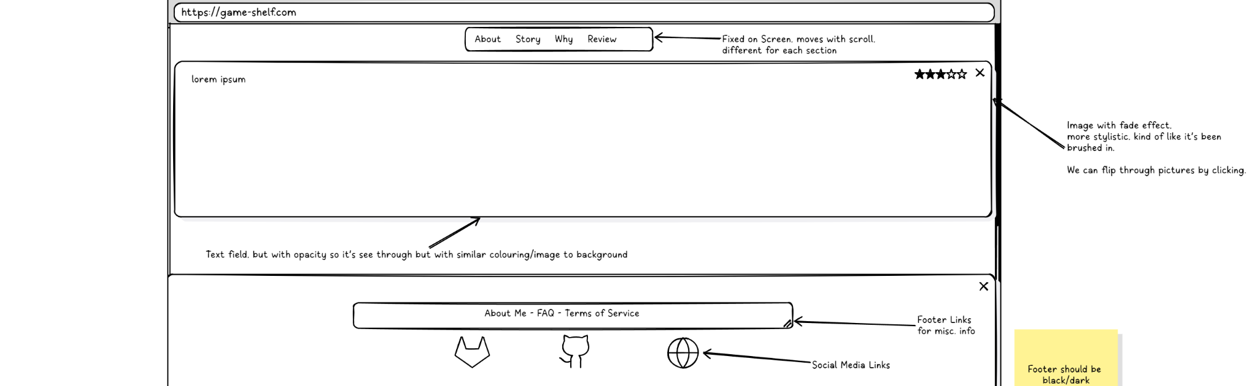
Wireframe for Bottom Page
*

Slide 7
Goals
...
Learn
CSS
HTML
JS
Frame0
No dependency on frameworks
Use
Plan
Wireframing tools
CSS Masks
Mainly planned using Frame0 for the outline of the webpage.

Slide 8
Difficulties and lessons learned
{
Difficulties
Lessons
Github Pages not dealing well with CSS file paths.
Getting image masking to work separately for pages using as little code as possible.
Usage of frame0 is great for outlining a webpage!
Combining several classes on elements is super helpful.
Creating a robust, extendable html basis makes writing css much easier!
}
*

Slide 9
Showing the actual page!
How it works, what was my design principle?
The bad:
Code could still use some refactoring
GitHub Pages does not play nicely with
image paths.
The good:
Varied design for all pages! Learned a ton of css!
Frame0 is super-helpful!
*

Slide 10
Thank you
{
..
}
..

Slide 11
Please keep this slide for attribution

